Slide 1

TINYML For acoustic analysis
David & Kyle

Slide 2
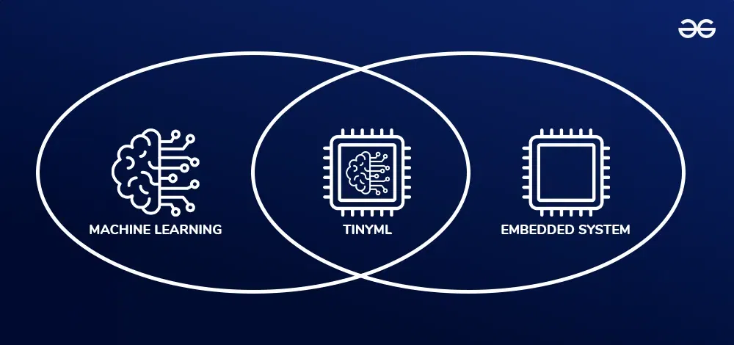
What is TinyML?
Practice of deploying machine learning models on low-power embedded devices
Instead of sending data to the cloud:
  Data is collected locally
  AI runs directly on the device
  Decisions are made in real time
Intelligence without requiring internet connectivity

Slide 3
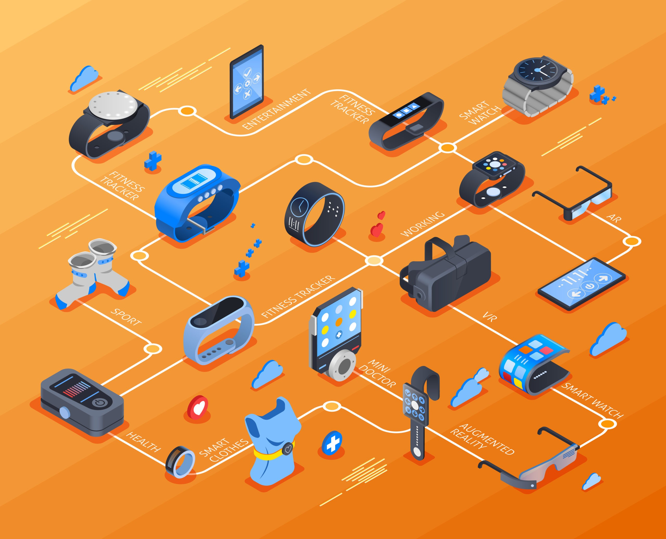
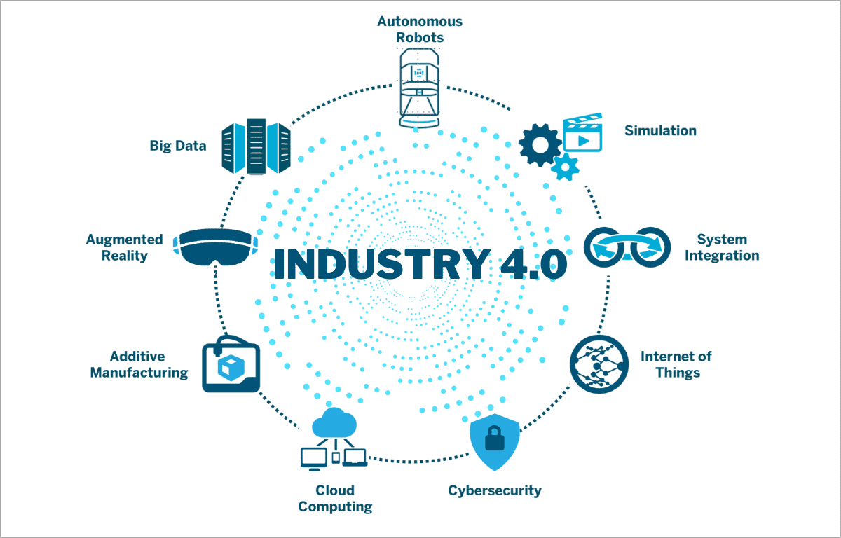
Real World Applications and Growth
Applications:
  Smart watches
  Smart speakers
  Autonomous drones
  Manufacturing
  Environmental monitoring
  Healthcare devices
Market growth and future trends:
  Industry 4.0
  Edge AI
  Smart sensors
  IoT expansion
Billions of devices will eventually contain embedded AI

Slide 4
Why TinyML is Important
Traditional AI
TinyML
Sensor -> Cloud -> AI processing -> Result
Problems:
  Internet required
  Higher latency
  Privacy concerns
  Higher power consumption
Sensor -> Embedded Device -> Result
Benefits:
  Real-time decisions
  Low power consumption
  Improved privacy
  Reduced communication requirements

Slide 5
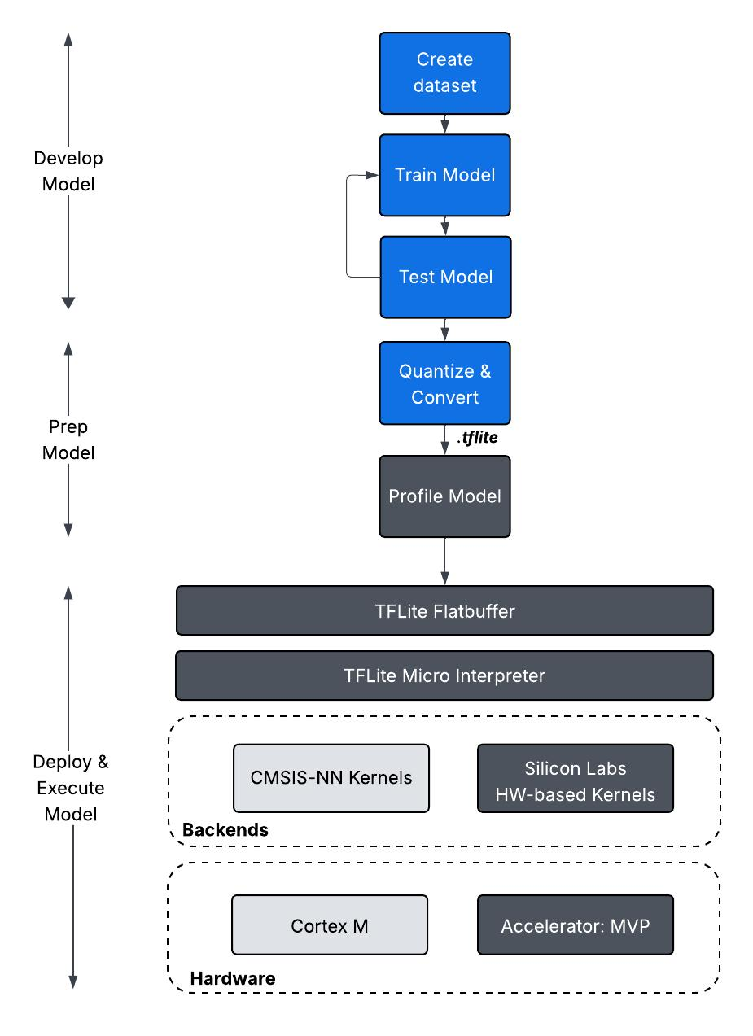
TinyML Architecture
General Workflow:
  Collect sensor data
  Train model on computer
  Optimize model
  Deploy to microcontroller
  Perform inference locally

Slide 6
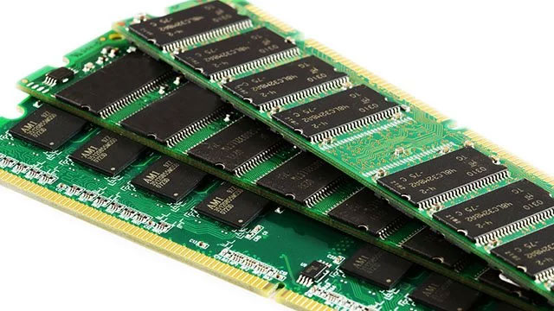
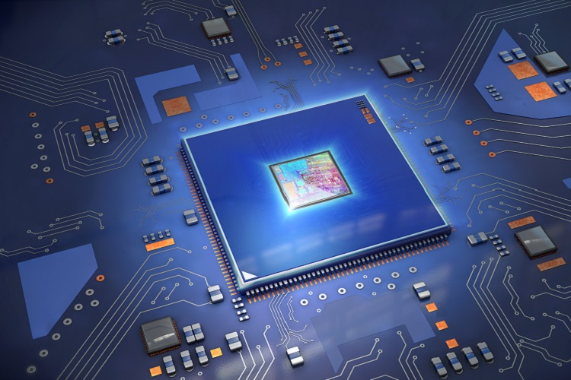
Challenges of TinyML
Microcontrollers have:
  Limited RAM
  Limited Flash
  Limited CPU power
  Battery constraints
For example, a PC could have 32GB ram while a microcontroller has around 512KB
Limited processing power:
  Don’t have powerful CPUs or GPUs
  Complex AI models may take too long to run
  Real-time applications require fast inference

Slide 7
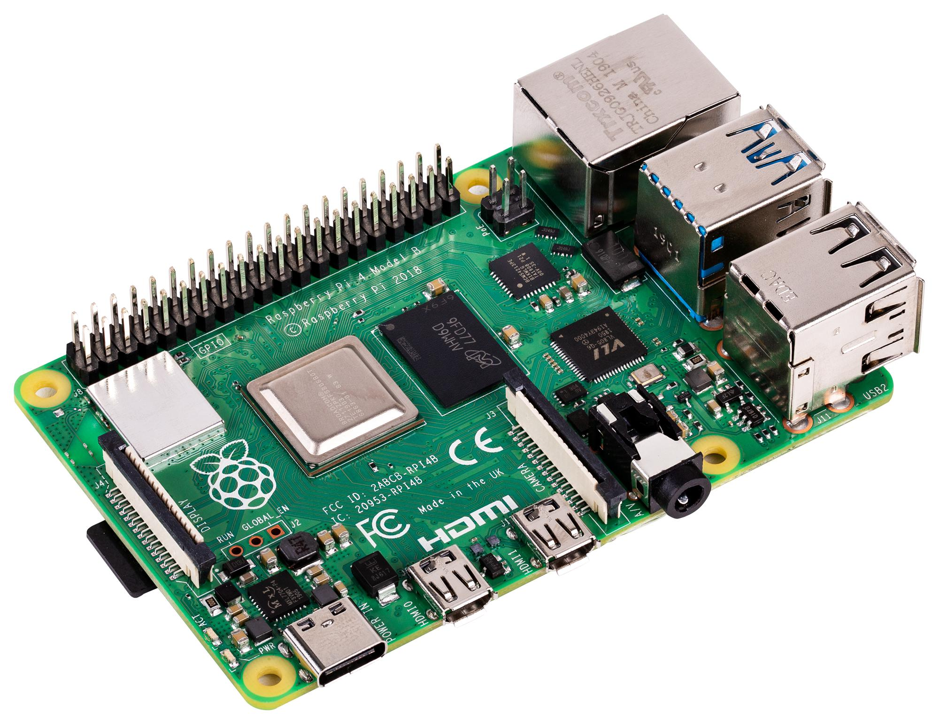
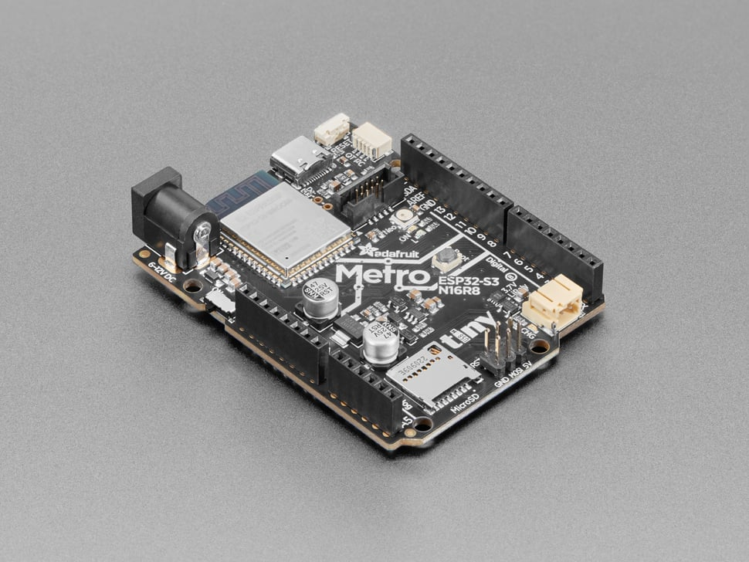
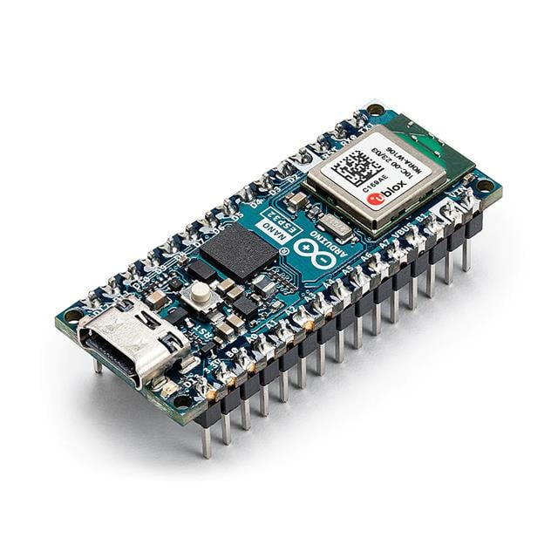
Hardware Used in TinyML
Common Platforms
  ESP32-S3
  STM32
  Arduino Nano 33 BLE Sense
  Raspberry Pi Pico
Why ESP32-S3?
Our capstone already uses:
  ESP32-S3
  MEMS microphone
  Wi-Fi communication
  This makes it an ideal TinyML platform.

Slide 8

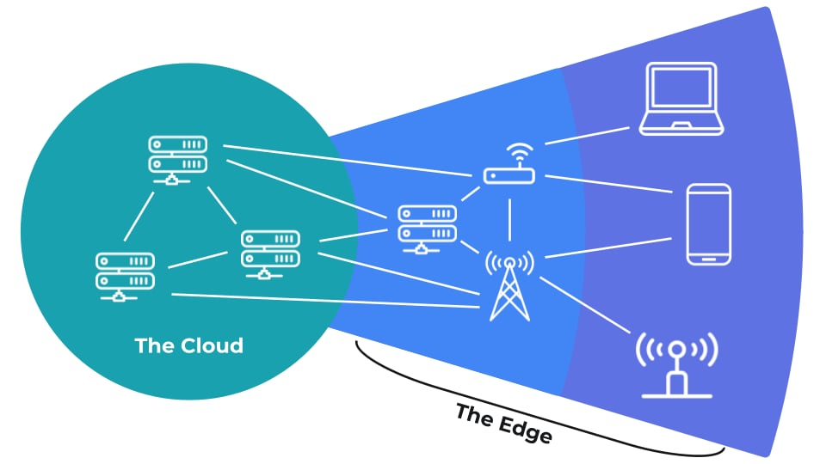
TinyML Development Tools
TensorFlow Lite for Microcontrollers
  Lightweight ML framework
  Runs neural networks on microcontrollers
Edge Impulse
  Data collection
  Model training
  Model deployment
Advantages
  Easy deployment
  Optimized for embedded systems
  Supports ESP32 devices

Slide 9
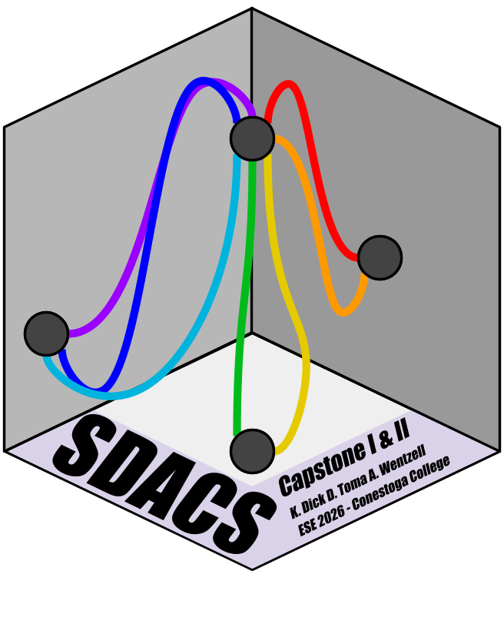
Integration to SDACS – Current Workflow
Current Functions
  Sound Pressure Level (SPL)
  FFT Analysis
  Frequency Response
  Room Acoustic Measurements
  Wireless Data Collection
Current Workflow
  Microphone → ESP32-S3 DSP → TinyML inference → MQTT/Node-RED → Flutter AI result display
The system measures sound but does not currently interpret it.

Slide 10
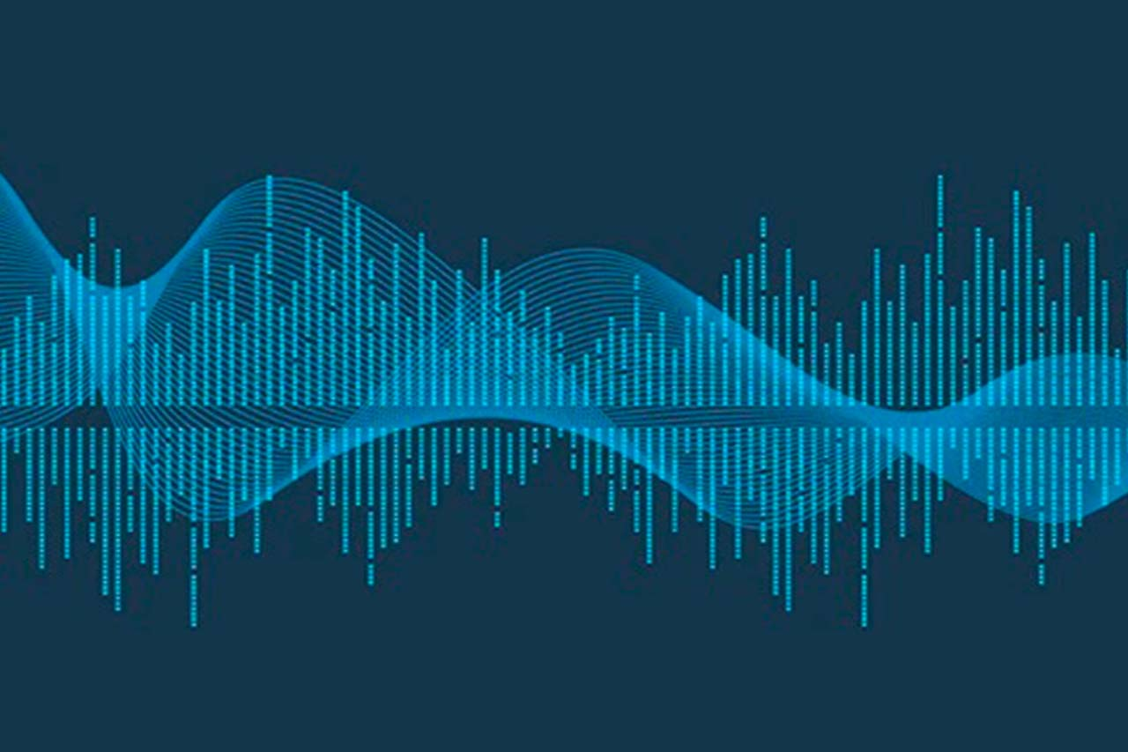
Integration to SDACS – New Workflow
Microphone → DSP Processing → TinyML Model → AI Prediction → App Display
AI Capabilities:
The system could automatically:
  Classify room types
  Detect echo issues
  Detect excessive reverberation
  Evaluate speech intelligibility
  Recommend acoustic treatments
The device becomes an intelligent acoustic assistant.

Slide 11
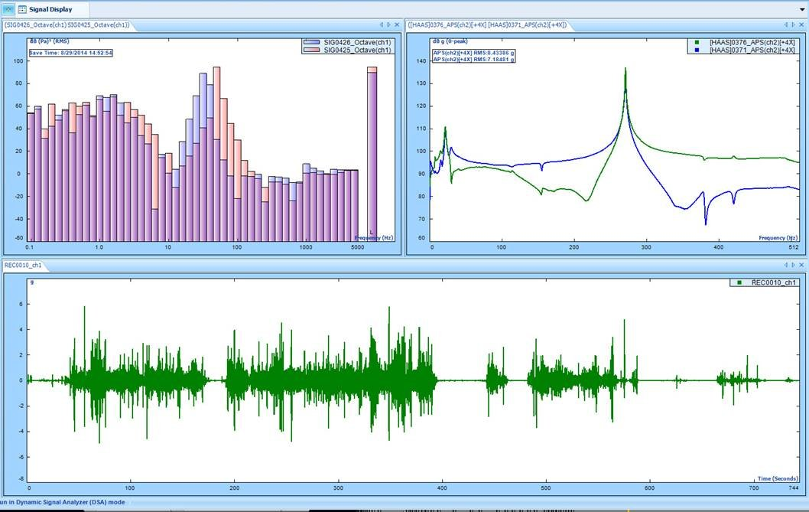
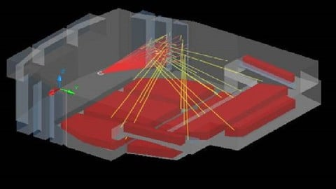
How it Benefits Our Capstone
Technical Benefits
  Real-time acoustic intelligence
  Local processing
  Reduced server workload
  Faster analysis
Educational Benefits: Combines
  Artificial Intelligence
  Machine Learning
  Embedded Systems
  Signal Processing
  IoT
  Acoustic Engineering
Industry Relevance
Growing use of Edge AI and TinyML in modern engineering systems.

Slide 12
TinyML Limitations & Better AI/ML Alternatives
TinyML limitations for SDACS
Needs a labelled acoustic dataset before predictions are reliable
ESP32-S3 RAM, flash, and CPU limit model size and inference speed
Raw-audio ML adds DSP, memory, and battery load
Harder to debug than the current SPL / FFT telemetry pipeline
More practical AI/ML path
1. Rule-based acoustic intelligence now
  Use SPL, FFT bands, noise floor, and thresholds to flag noise, echo, and low-frequency buildup.
2. RPi5 / Node-RED or Flutter-side ML next
  Keep ESP32 nodes focused on sensing; run classifiers and recommendations on the server/app.
3. TinyML later
  Deploy a small feature-based model only after the dataset and benchmarks are proven.
Current SDACS
SPL + FFT Data
Server/App AI
Rules or ML
Future TinyML
On-node inference
Recommendation: present TinyML as future work; implement server/app-side
intelligence first for a stronger, lower-risk SDACS demo.

Slide 13

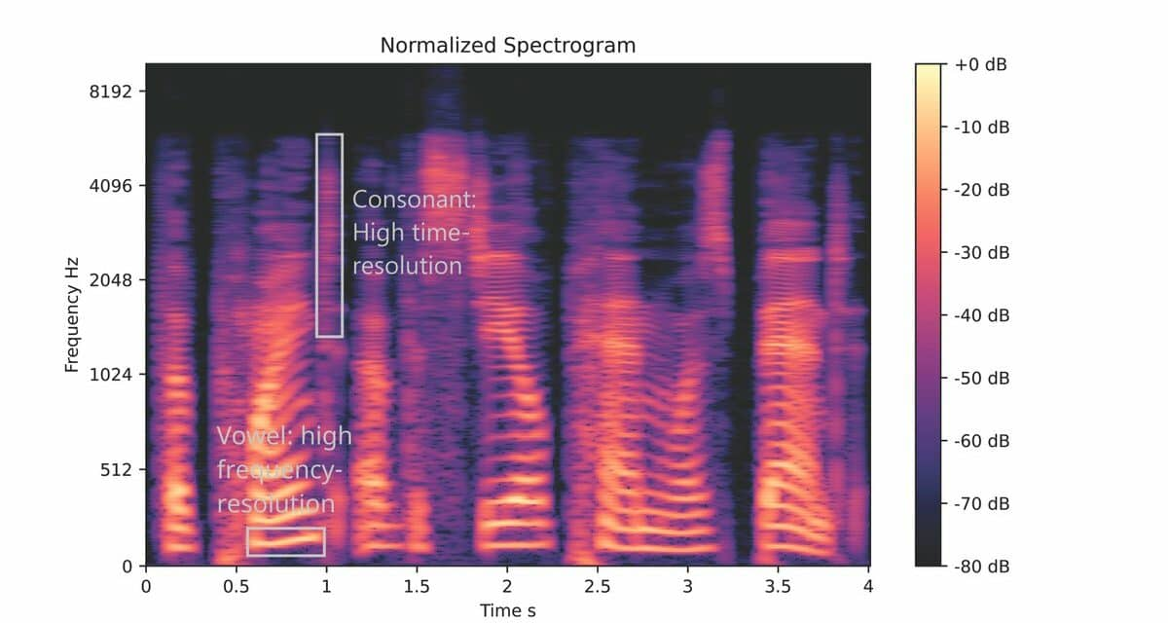
Conclusion
Key Takeaways
  TinyML enables AI on low-power embedded devices.
  ESP32-S3 hardware supports TinyML applications.
  SDACS could use TinyML to automatically analyze room acoustics.
  AI would transform the project from a measurement system into an intelligent acoustic analysis platform.
Future Work
  Collect acoustic datasets
  Train room-classification models
  Deploy TinyML models on ESP32-S3
  Integrate AI results into Flutter application

Slide 14
References
[1] Edge Impulse, "Edge Impulse: Edge AI Development Platform," Available: https://www.edgeimpulse.com/
[2] Google AI for Developers, "LiteRT for Microcontrollers," Available: https://ai.google.dev/edge/litert/microcontrollers/overview
[3] TinyML Foundation, "TinyML Foundation," Available: https://tinyml.org/
[4] Espressif Systems, "ESP32-S3 Series," Available: https://www.espressif.com/en/products/socs/esp32-s3

